Slide 1
Digital Modulation Techniques Chapter 3
Topics Discussed
Basics principles of
Amplitude Shift Keying( ASK)
Frequency Shift Keying( FSK) and
Phase Shift Keying (PSK)-BPSK and QPSK
QAM

Slide 2
Digital Modulation
In digital Modulation
Modulating Signal -----Digital
Carrier Signal ------------Sinusoidal

Slide 3
Types
Amplitude Shift Keying( ASK)
Frequency Shift Keying( FSK) and
Phase Shift Keying (PSK)-BPSK and QPSK

Slide 4
Amplitude Shift Keying( ASK)
In ASK the binary information directly modulates the amplitude of analog carrier
Also known as Digital Amplitude Modulation (DAM).
Only two output amplitudes possible as compared with Amplitude Modulation.

Slide 5
Modulating Signal
1
0
0
1
0
Amplitude Shift Keying
A cos(ωt)
Acos(ωt)

Slide 6
Mathematically ASK is
V(ask) (t) =[1+vm(t)] [ Ac Cos(ωct)/2] (1)
Where
V(ask)(t) ---------- ASK wave
vm(t)----------------binary modulating signal
Ac/2 ----------------un-modulated carrier amplitude (volts)
ωc -------- analog carrier frequency in radians per sec.

Slide 7
For logic 1 input vm(t)=1 and thus equation 1 reduces to
V(ask) (t) = A Cos(ωct)]
For logic 0 input vm(t)=-1 and thus equation 1 reduces to
V(ask) (t) = 0
Carrier is on or off (OOK ON OFF KEYING )

Slide 8
Frequency Shift Keying (FSK)
Mathematically FSK is
V (fsk)(t) = Vc Cos[2𝜫(fc + vm(t) 𝝙f )]t (2)
Where
𝝙f ------ peak shift in analog carrier frequency in HZ vm(t)----------binary input modulating Signal
For logic 1 input vm(t)=1
V(fsk) (t) = Vc Cos[2𝜫(fc + 𝝙f )]t
For logic 0 input vm(t)=-1
V(fsk) (t) = Vc Cos[2𝜫(fc - 𝝙f )]t

Slide 9
Baseband Data
1
0
0
1
BFSK modulated
signal
f_{m}
f_{s}
f_{s}
f_{m}
BINARY INPUT | FREQUENCY OUT
0 | Space (fs)
1 | Mark (fm)

Slide 10
binary input signal changes from logic 0 to logic 1 and vice versa ,output frequency shifts between two frequencies
mark (logic 1 frequency fm)
space (logic 0 frequency fs
𝝙f
𝝙f
fs
fc
fm
2𝝙f =│( fm-fs)│
Notes:
fc is shifted up and down in frequency domain by the binary input signal .

Slide 11
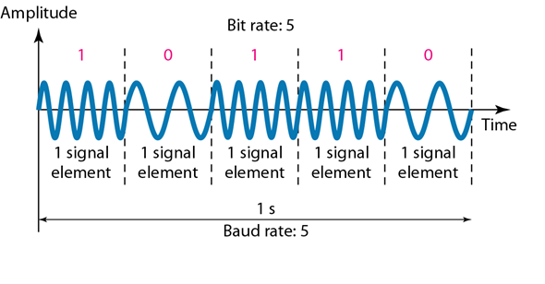
FSK Bit rate ,Baud and Bandwidth
Bit time is equal to the time of an FSK signaling element and Bit rate is equals baud .
Baud rate can mathematically calculated by substituting N=1 in following equation
Baud=fb/N baud=fb

Slide 12
Bandwidth of FSK
Minimum Band Width for FSK
B=│(fs-fb)-(fm-fb) │
B= │(fs-fm)│+2fb
B=2(𝝙f +fb)
which resembles with the Carson’s rule .

Slide 13
Phase Shift Keying
Phase shift of the carrier signal to represent digital data.
Simplest form of PSK is Binary phase shift Keying where N=1 and M=2.
Two phases are possible for the carrier.
Input changes state the phase of output Carrier shifts between two angles separated by 180 degrees.
Also known as phase reversal keying and bi-phase modulation

Slide 14
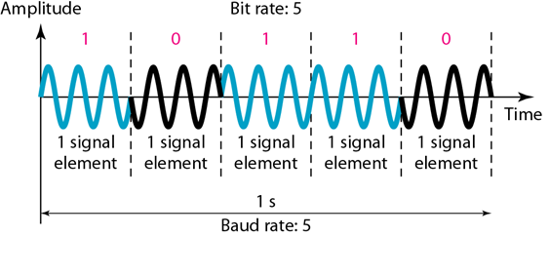
Bit rate(fb) is equal to baud rate and Bandwidth B=fb

Slide 15
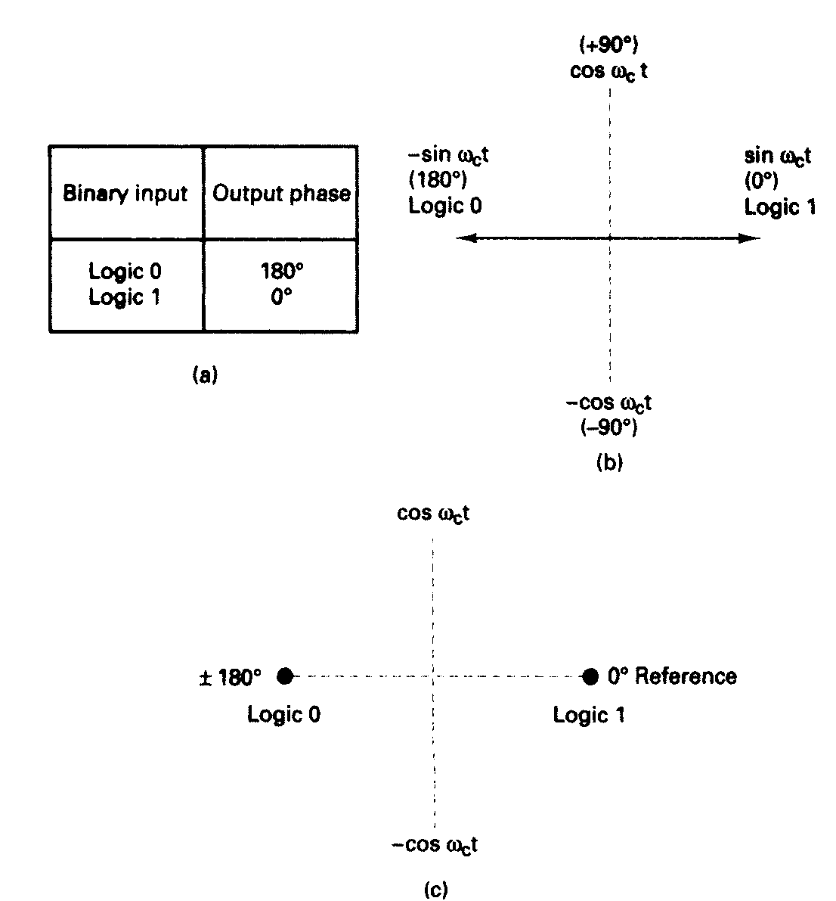
QPSK modulator: (a) truth table; (b) phasor diagram; (c) constellation diagram
Notes:
CONSTELLATION DIAGRAM OR SIGNAL STATE SPACE DIGRAM --------------ONLY THE RELATIVE POSITIONS OF THE THE PEAKS OF THE PHASORS ARE SHOWN

Slide 16
Quaternary phase shift keying (QPSK)
It is M-ary encoding scheme where N=2 and M=4.
4 output phases are possible for single carrier frequency.
With 2 bits 4 possible conditions 00,01,10,11 are possible .Thus with QPSK the binary input data are combined into groups of two bits called as dibits

Slide 17
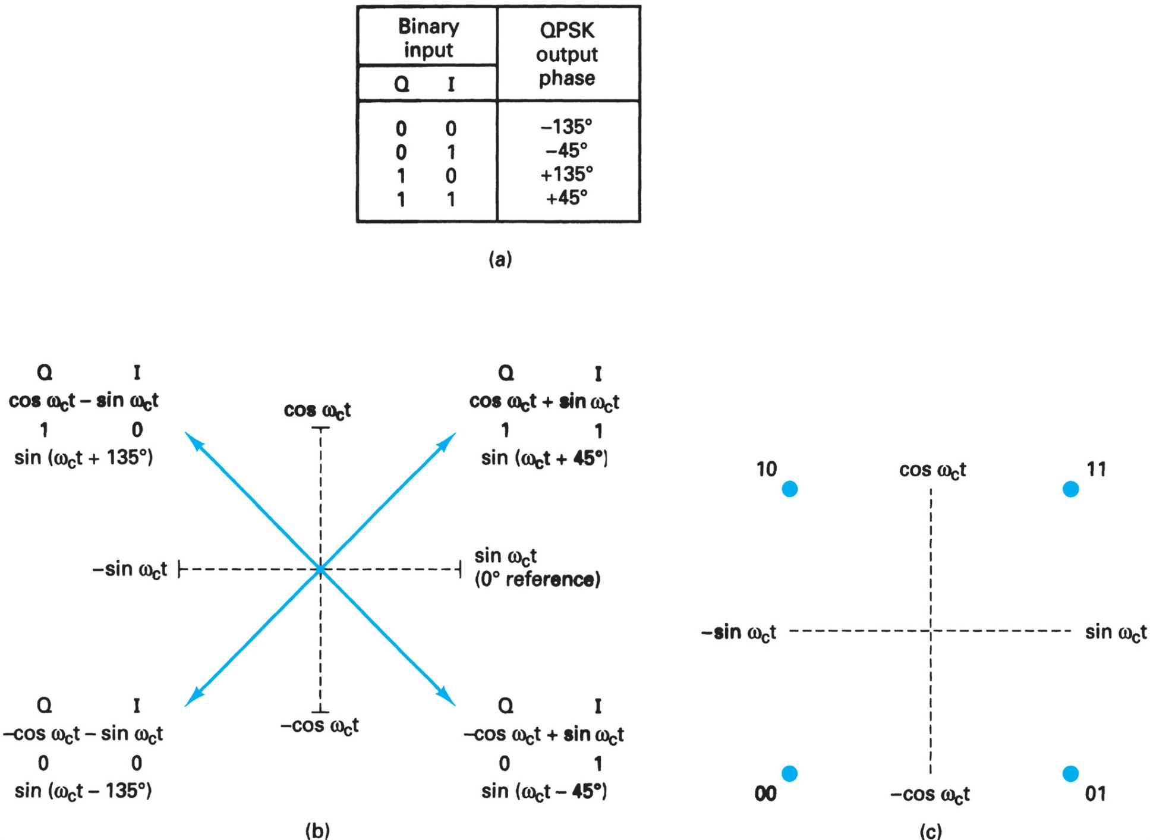
QPSK modulator: (a) truth table; (b) phasor diagram; (c) constellation diagram
T

Slide 18
Constellation Diagram for QPSK
baud is equal to half the input bit rate .
Band width is equal to fb/2(bandwidth compression)
Q
I
π/4, 3π/4, 5π/4, 7π/4

Slide 19
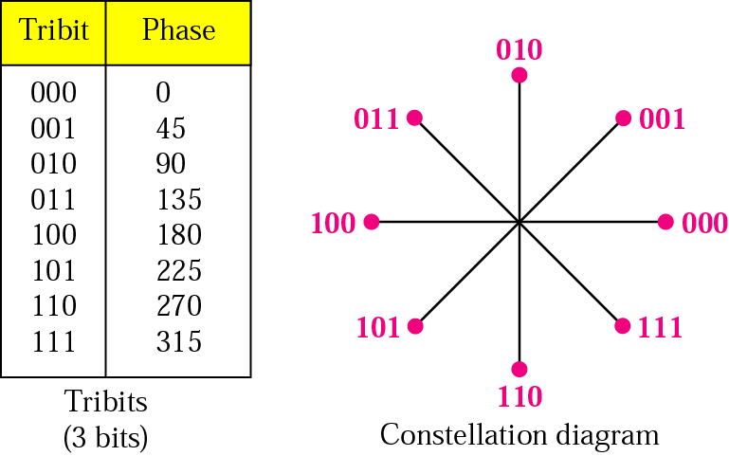
8-PSK
We can extend, by varying the signal by shifts of 45 degrees (instead of 90 degrees in QPSK)
With 8 = 2³ different phases, each phase can represents 3 bits (tribit).

Slide 20
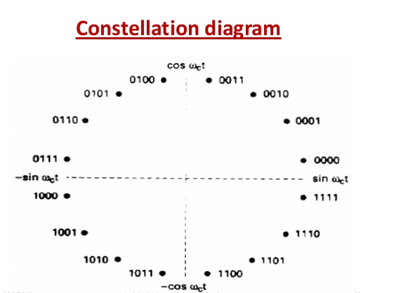
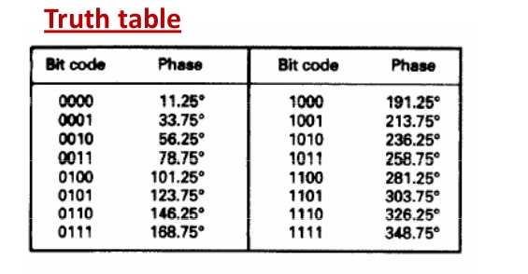
16PSK
M=16 ,so there are 16 different output phases possible
With 16PSK ,four bits (quad bits ) are combined .
Baud rate=B.W=fb/4

Slide 21
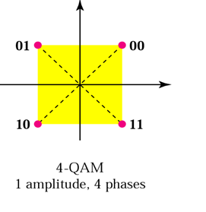
Quadrature Amplitude Modulation
Quadrature amplitude modulation is a combination of ASK and PSK
x variations in phase and y variations of amplitude
x • y possible variation (greater data rates)
Numerous variations of QAM ---- (4QAM, 8QAM,16QAM )
4 QAM --------- four possible phase shifts and one different carrier amplitudes.
# of phase shifts > # of amplitude shifts

Slide 22
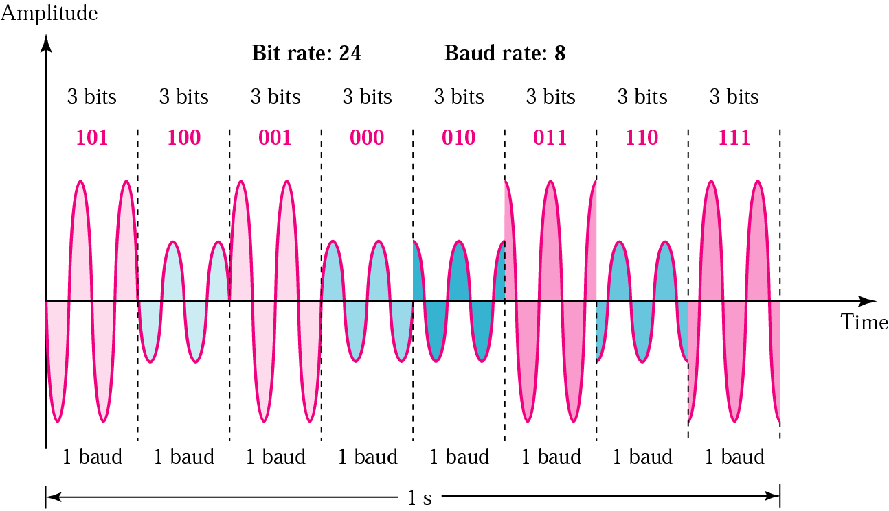
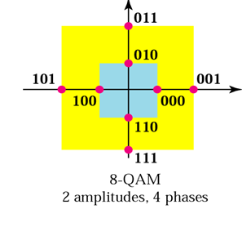
8 QAM
Four possible phase shifts and two different carrier amplitudes.
Eight different states can be transmitted.
With eight states, 3 bits can be encoded for each baud or symbol transmitted.
Each 3-bit binary word transmitted uses a different phase-amplitude combination.

Slide 23
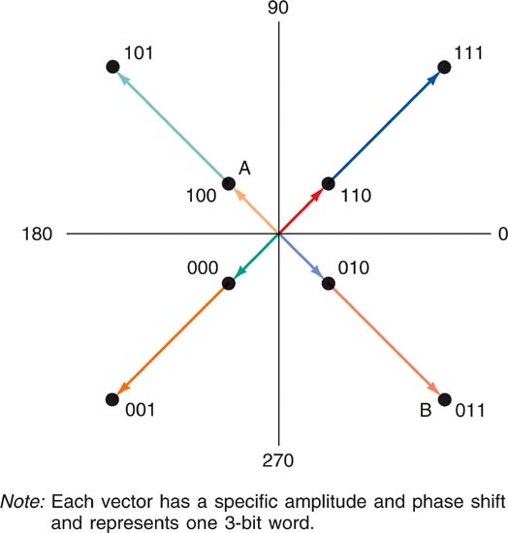
The two magnitudes for 8QAM are 0.765 and 1.848
Binary Number |  |  | Amplitude and Phase
0 | 0 | 0 | 0.765, (-135deg)
0 | 0 | 1 | 1.848, (-135deg)
0 | 1 | 0 | 0.765(-45deg)
0 | 1 | 1 | 1.848(-45 deg)
1 | 0 | 0 | 0.765(135deg)
1 | 0 | 1 | 1.848(135deg)
1 | 1 | 0 | 0.765 (45deg)
1 | 1 | 1 | 1.848(45deg)

Slide 24
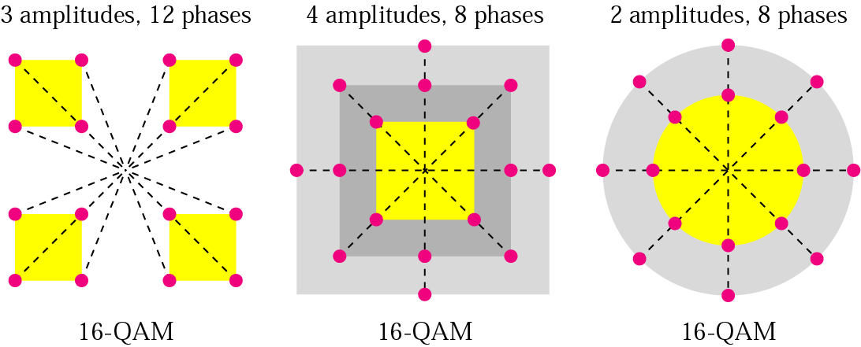
16QAM
8 possible phase shifts and two different carrier amplitudes.
16 different states can be transmitted.
With 16 states, 4 bits can be encoded for each baud or symbol transmitted.

Slide 25
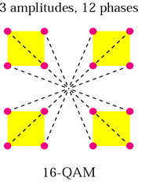
0 | 0 | 0 | 0 | 0.311 | -135 deg
0 | 0 | 0 | 1 | 0.850 | -165 deg
0 | 0 | 1 | 0 | 0.311 | -45
0 | 0 | 1 | 1 | 0.850 | -15
0 | 1 | 0 | 0 | 0.850 | -105
0 | 1 | 0 | 1 | 1.161 | -135
0 | 1 | 1 | 0 | 0.850 | -75
0 | 1 | 1 | 1 | 1.161 | -45
1 | 0 | 0 | 0 | 0.311 | 135
1 | 0 | 0 | 1 | 0.850 | 165
1 | 0 | 1 | 0 | 0.311 | 45
1 | 0 | 1 | 1 | 0.850 | 15
1 | 1 | 0 | 0 | .850 | 105
1 | 1 | 0 | 1 | 1.161 | 135
1 | 1 | 1 | 0 | 0.850 | 75
1 | 1 | 1 | 1 | 1.161 | 45
1110(14)
1111(15)
1101(13)
1100(12)
1001(9)
1000(8)
1010(10)
1011(11)
0000(0)
0010(2)
0011(3)
0001(1)
0101(5)
0100(4)
0110(6)
0111(7)

Slide 26
Comparison
Modulation | Units | Bits/Baud | Baud rate | Bit Rate
ASK, FSK, 2-PSK | Bit | 1 | N | N
4-PSK, 4-QAM | Dibit | 2 | N | 2N
8-PSK, 8-QAM | Tribit | 3 | N | 3N
16-QAM | Quadbit | 4 | N | 4N
32-QAM | Pentabit | 5 | N | 5N
64-QAM | Hexabit | 6 | N | 6N
128-QAM | Septabit | 7 | N | 7N
256-QAM | Octabit | 8 | N | 8N

